Slide 1


Enabling Self-service Data Provisioning through Semantic Enrichment of Data
Ahmad Assaf
Supervisors: Raphaël Troncy and Aline Senart
Enabling Self-service Data Provisioning Through Semantic Enrichment of Data
18th December 2015

Slide 2
Thesis Context
Towards A Complete Dataset Profile
Harmonized dataset model
Automatic datasets profiles generation and validation
Datasets objective quality assessment
Enriching Enterprise Data
External data integration and enrichment
Semantic Social News Aggregation
Enabling Self-service Data Provisioning Through Semantic Enrichment of Data

Slide 3
Outline
Introduction
Use-case Scenario
Research Challenges
Proposal
Contributions
Towards A Complete Dataset Profile
Towards Enriched Enterprise Data
Perspectives
Publications
Enabling Self-service Data Provisioning Through Semantic Enrichment of Data

Slide 4
Introduction
Enterprises use a wide range of heterogeneous information systems in their business activities such as Enterprise Resource Planning (ERP), Customer Relationships Management (CRM) and Supply Chain Management (SCM) systems
An enterprise distributed IT landscape contains multiple systems using different technologies and data standards
Business Intelligence (BI) has always been about creating new insight for business by converting data into meaning that can be shared between people to drive change in the organization
However, provisioning data for those visualizations is by far the most challenging task in most BI projects large and small
Enabling Self-service Data Provisioning Through Semantic Enrichment of Data
Notes:
Enterprises use a wide range of heterogeneous information systems in their business activities such as Enterprise Resource Planning (ERP), Customer Relationships Management (CRM) and Supply Chain Management (SCM) systems
Add numbering (1/3)
Add a report picture to introduce BI

Slide 5
Introduction
The quality and amount of structured knowledge available on the web make it now feasible for companies to mine this huge amount of public data
Linked Open Data (LOD) cloud has grown from 12 datasets cataloged in 2007, it has grown today to nearly 1000 datasets containing more than 82 billion triples
Social Networks are transforming Web usage in terms of users' initial entry point, search, browsing and purchasing behavior
Enabling Self-service Data Provisioning Through Semantic Enrichment of Data
Notes:
Data becomes more useful when it is open, widely available, in shareable formats and when advanced computing and analysis can yield from it.
Less text | no need for the LOD cloud numbers
add more to present other data than lod cloud

Slide 6
Introduction
Preparing and gathering data for reporting and visualization is by far the most challenging task in most BI projects large and small
Self-service data provisioning aims at reducing the challenge by providing dataset discovery, acquisition and integration techniques intuitively to the end user
Enabling Self-service Data Provisioning Through Semantic Enrichment of Data

Slide 7
Use-case Scenario - Personas
Dan FERRY
Paul PARKER
Paris, France
London, UK
Data Analyst
Data Portal Administrator
Ministry of Transport
data.gov.uk
I collect and acquire #data from multiple data sources, filter and clean data, interpret and analyze results and provide ongoing reports
I monitor the overall health of the portal. Also oversee the creation of users, organizations and datasets
Yesterday
2 days ago
I try to ensure a certain #dataQuality level by continuously checking for spam and manually enhancing dataset descriptions and annotations
J’adore #SAP #Lumira #dashboard #visualization #BI http://go.sap.com/product/analytics/lumira.html
3 days ago
1 week ago
Enabling Self-service Data Provisioning Through Semantic Enrichment of Data
Notes:
SAP Lumira a self-service data visualization tool that makes it easy to import data from multiple sources, perform visual BI analysis using intuitive dashboards, interactive maps, charts, and infographics

Slide 8
Use-case Scenario
Dan receives a memo from his management to create a report comparing the number of car accidents that occurred in France for this year, to its counterpart in the United Kingdom (UK).
Dan asked to highlight accidents related to illegal consumption of alcohol in both countries.
Enabling Self-service Data Provisioning Through Semantic Enrichment of Data
Notes:
After examining the ministry's records, Dan is able to collect the data needed to create his report for the French side. Dan also issues an official request to the Department of Transport in UK to collect the data needed. However, Dan knows that the process takes a long time and his management needs the report within days. Dan is familiar with the Open Data movement and starts his journey searching through different data portals in the UK.
add paul here

Slide 9
Research Challenges
Dataset Maintenance & Discovery
Find useful datasets for specialized domains
Quickly assess datasets by checking the attached metadata
Generate and validate datasets descriptions and metadata
Detect spam and irrelevant datasets
Dataset Quality
Automatic tools to issue scores or certificates reflecting the objective dataset quality
Check if the dataset on hand is of a certain degree of quality to be used in reports
Enabling Self-service Data Provisioning Through Semantic Enrichment of Data
Notes:
relate the challenges to the personas
add colors coding as well

Slide 10
Research Challenges
Dataset Integration and Enrichment
Map and organize the data in order to have a unified view for these heterogeneous and complex data structures
Finding the most relevant entity type within a given context
Assess which entity’s properties are more important than others for particular tasks
The vast amount of data available in social networks makes it hard to spot what is relevant in a timely manner
Enabling Self-service Data Provisioning Through Semantic Enrichment of Data

Slide 11
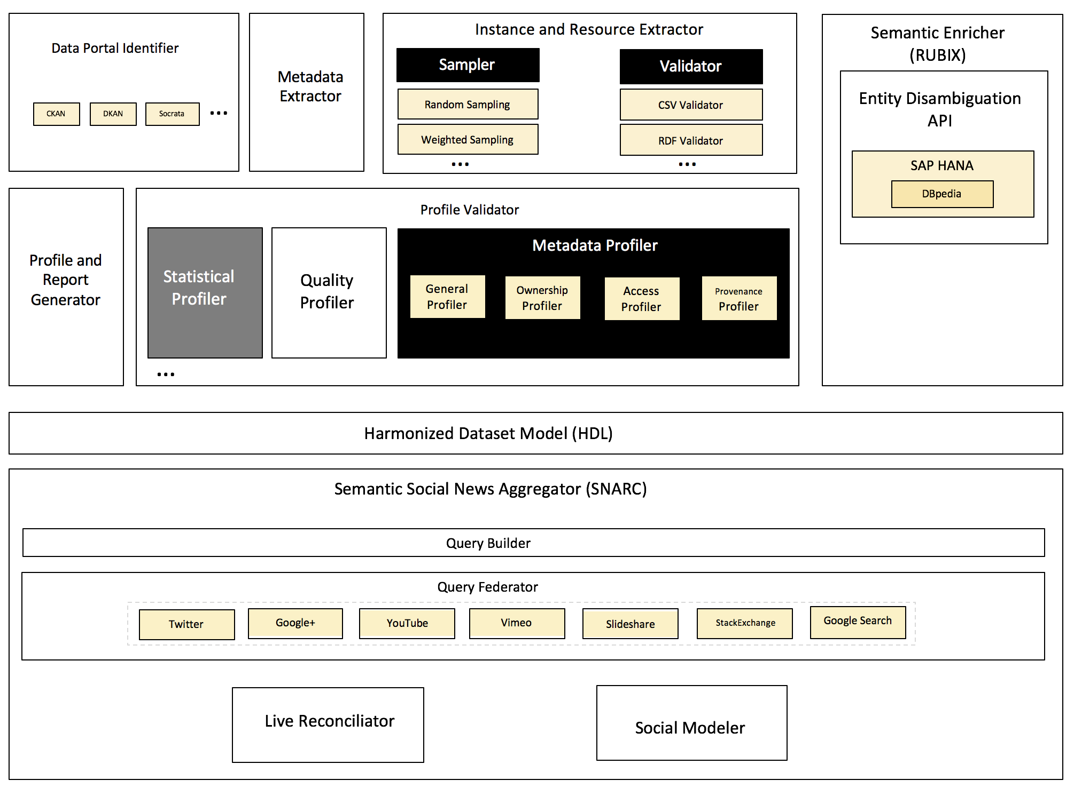
Proposal
Dataset Maintenance & Discovery
Dataset Quality
Dataset Integration & Enrichment
Enabling Self-service Data Provisioning Through Semantic Enrichment of Data
Notes:
visit the architeture diagram (bigger fonts)

Slide 12
PART I
Towards A Complete Dataset Profile
Research Challenges
Dataset Maintenance & Discovery
Dataset Quality
Enabling Self-service Data Provisioning Through Semantic Enrichment of Data

Slide 13
Dataset Metadata/Profile
Metadata is structured information that describes, explains, locates or otherwise makes it easier to retrieve use or manage information resources
Data Discovery, exploration and reuse
Archiving
&
preservation
Organization
&
identification
Enabling Self-service Data Provisioning Through Semantic Enrichment of Data
Notes:
example of metadata

Slide 14
Data Portals/Data Management Systems
Data Portals (Catalogs) are the entry points to discover published datasets
Data Portals are a curated collection of datasets metadata providing a set discovery and integration services.
Data Portals can be private like datahub.io, publicdata.eu or private like enigma.io or quandle.com
Portals are built on top of Data Management Systems (DMS) like CKAN, DKAN and Socrata
Enabling Self-service Data Provisioning Through Semantic Enrichment of Data
Notes:
screenshot of a dataportal
private like or private like

Slide 15
Dataset Models
Data Catalog Vocabulary (DCAT) is an RDF vocabulary with three main classes: dcat:Catalog, dcat:Dataset and dcat:Distribution
DCAT-AP defines a minimal set of properties that should be included in a datasets profile by specifying mandatory and optional properties
The Asset Description Metadata Schema (ADMS) is used to semantically describe assets (code lists, taxonomies, vocabularies)
Vocabulary of Interlinked Datasets (VoID) is an RDF vocabulary to describing datasets and the links between them with three main classes: void:Dataset, void:Linkset and void:subset
Enabling Self-service Data Provisioning Through Semantic Enrichment of Data
Notes:
say that there lots of dataset models
are they generic or specific

Slide 16


Dataset Models
Dataset Models
Commercial platform to streamline data publishing, management, analysis and reusing.
The model is designed specifically to represent tabular data
The model covers a basic set of metadata properties and has good support for geospatial data
A collection of schema used to markup HTML pages with structured data
Covers many domains. We are interested in the Dataset schema although we also use various properties from schemas like organizations, authors, etc.
Online collection of best practices and case studies to help data publishers
POD data model is based on DCAT
Similarly to DCAT-AP, POD defines three types of metadata elements: Required, Required-If and Expanded(optional)
Metadata extensions using elements from the “Expanded” fields
Enabling Self-service Data Provisioning Through Semantic Enrichment of Data
16

Slide 17
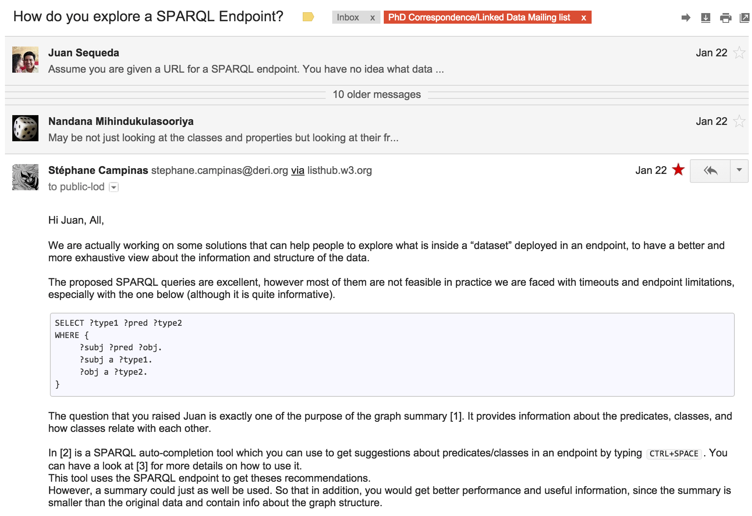
Why a Harmonized Model ?
Exploring/discovering datasets for (re)use
Defining a “minimal” set of information needed to build a “profile”
Building tools that will automatically generate/validate metadata models
Enabling Self-service Data Provisioning Through Semantic Enrichment of Data
Notes:
play with the order

Slide 18
Metadata Model Classification
A dataset can contain four main Information groups:
Resource
Actual raw data that can be downloaded or accessed directly e.g. JSON, CSV, SPARQL endpoint
Tag
Descriptive knowledge about the dataset contents and structure. This can range from simple textual tags to semantically rich controlled terms
Group
Organizational units that share common semantics. They can be seen as a cluster or curation based on shared themes/categories
Organization
Clustering or curation solely based on associations with specific administration parties
Enabling Self-service Data Provisioning Through Semantic Enrichment of Data
Notes:
shorten text and sharpen it

Slide 19
Metadata Model Classification
A dataset can contain the following Information types:
Resource
Tag
Organization
Group
General Information
Statistical Information
title, description, id
max_value, uniques, average
Quality Information
Access Information
rating, availability, freshness
URL, license_title, license_id
Ownership Information
Geospatial Information
author, maintainer_email
bbox, layers
Provenance Information
Temporal Information
version, creation_date, update_date
coverage_from, coverage_to
Enabling Self-service Data Provisioning Through Semantic Enrichment of Data
Notes:
algin temporal information
Information not capital I

Slide 20
Mapping Datasets Models
Examine the model or vocabulary specification and documentation
Examine existing datasets using these models
Examine the source code for DMS
1
Map the information groups [resource, tag, group, organization]
2
Map the information types [general, ownership, provenance, etc.]
CKAN | DKAN | POD | DCAT | VoID | Schema.org | Socrata
resources | resources | distribution | Dcat:Distribution | Void:Dataset →void:dataDump | Dataset:distribution | attachments
tags | tags | keyword | Dcat:Dataset → :keyword | Void:Dataset → :keyword | creativeWork:keywords | tags
Enabling Self-service Data Provisioning Through Semantic Enrichment of Data

Slide 21
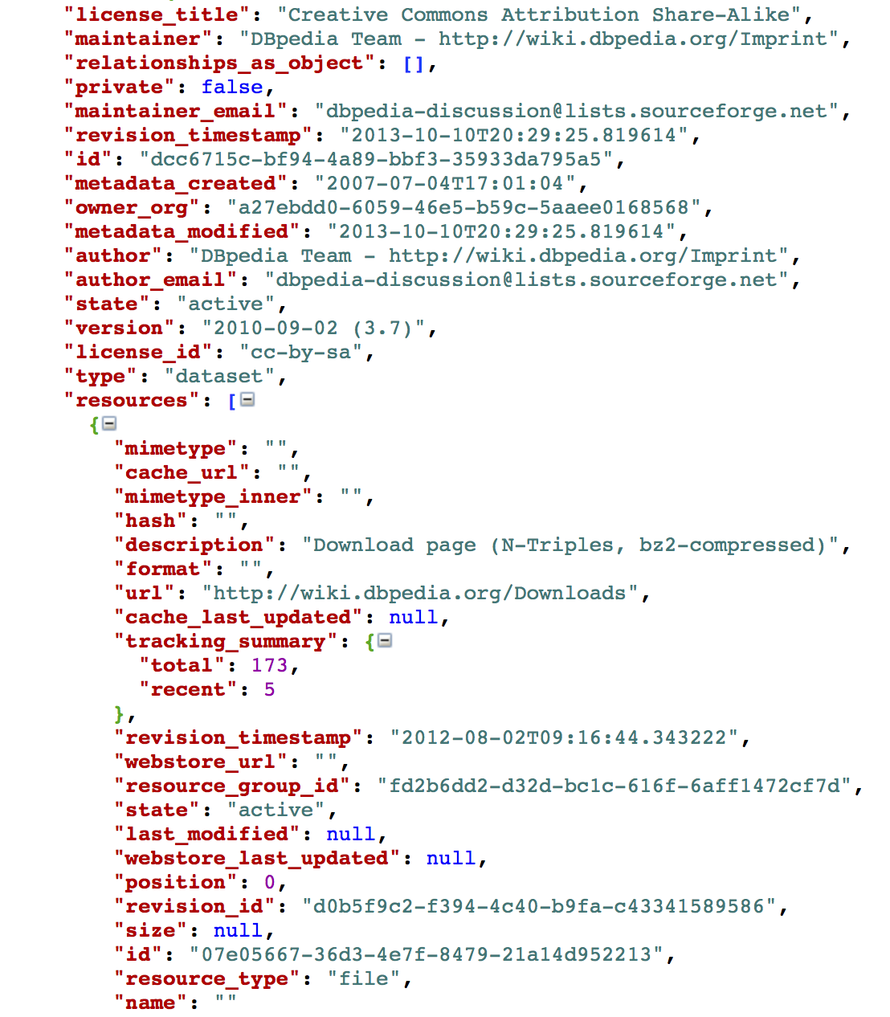
Mapping Datasets Models
CKAN
maintainer_email
DKAN
maintainer_email
POD
ContactPoint -> hasEmail
DCAT
dcat:Dataset -> dct:creator -> foaf:Person:givenName
VoID
void:Dataset -> dct:creator -> foaf:Person:givenName
Schema.org
CreativeWork:producer -> Person:email
Enabling Self-service Data Provisioning Through Semantic Enrichment of Data
21
Notes:
add numbering 1 and 2

Slide 22
Harmonized Dataset Model (HDL)
We noticed a lack of a complete model that covers all the information types
Examining the models, we noticed an abundance of information filled in “extras” fields
Using Roomba we generated aggregation reports to inspect those extras on LOD Cloud and OpenAfrica
1
Extra fields names and values
extras>value:extras>name
2
Types describing resources
resources>resource_type:resources>name
53% of the datasets in OpenAfrica have additional geospatial attached (spatial-reference-system, spatial harvester, bbox-east-long, bbox-north-long, bbox-south-long, bbox-west-long)
16% of the datasets have additional provenance and ownership information (frequency-of-update, dataset-reference-date)
https://github.com/ahmadassaf/opendata-checker/
Enabling Self-service Data Provisioning Through Semantic Enrichment of Data
22
Notes:
There is an abundance of extensions and application profiles that try to fill in those gaps, but they are usually domain specific addressing specific issues like geographic or temporal information
delete this

Slide 23
Harmonized Dataset Model (HDL)
There is an abundance of extensions and application profiles that try to fill in those gaps, but they are usually domain specific addressing specific issues like geographic or temporal information
HDL
5 Classes
61 properties
+ Controlled field values
resource_type: direct, accessible_bitstream, file.upload, api,
visualization, code, documentation
Enabling Self-service Data Provisioning Through Semantic Enrichment of Data
Notes:
There is an abundance of extensions and application profiles that try to fill in those gaps, but they are usually domain specific addressing specific issues like geographic or temporal information

Slide 24
Flashback | Revisiting Scenario
Paul will be able to use HDL as a basis to extend and present the datasets he controls
Paul knows what are the major dataset models out there, and what kind of metadata data owners need to fully represent their dataset
Paul can use HDL and the proposed mappings as a basis to extend Roomba to support various dataset models like DKAN or Socrata
Dan will be able to make fast decisions whether the dataset examined is suitable or not by examining the rich datasets metadata presented in HDL
Enabling Self-service Data Provisioning Through Semantic Enrichment of Data

Slide 25
Dataset Profiling
Data profiling is the process of creating descriptive information and collect statistics about that data. It is a cardinal activity when facing an unfamiliar dataset
Profiles reflect the importance of datasets without the need for detailed inspection of the raw data
Metadata provisioning is one of the Linked Data publishing best practices
Statistical Profiling
Metadata Profiling
Topical Profiling
Enabling Self-service Data Provisioning Through Semantic Enrichment of Data
Notes:
There is an abundance of extensions and application profiles that try to fill in those gaps, but they are usually domain specific addressing specific issues like geographic or temporal information
add references

Slide 26
Metadata Profiling | Related Work
Flemming’s data quality assessment tool Provides metadata assessment based on manual user input
ODI certificate provides descriptions of the published data quality in plain English based on an extensive survey filled by the publisher
Project Open Data Dashboard tracks and measures how US governments implements Open Data principles
The Datahub Validator gives an overview of data sources cataloged on the datahub
Enabling Self-service Data Provisioning Through Semantic Enrichment of Data
Notes:
implements -> implement
provide -> not capital P
Add conclusion

Slide 27
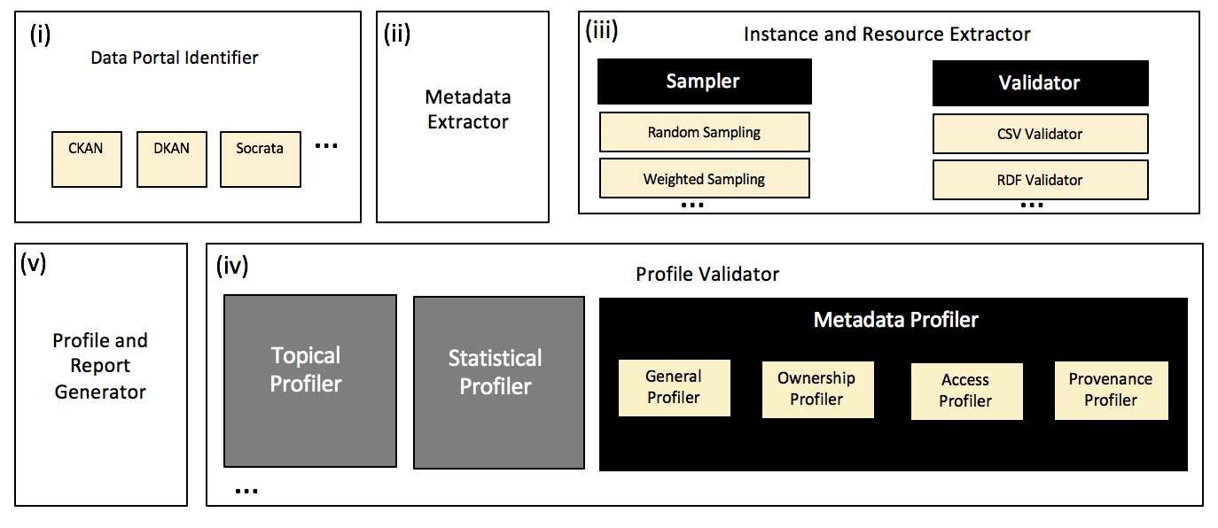
Our Proposal | Roomba
https://github.com/ahmadassaf/opendata-checker/
Enabling Self-service Data Provisioning Through Semantic Enrichment of Data
Notes:
Say Roomba instead of we

Slide 28
Data Portal Identification | step (I)
Roomba is extensible to any data portal exposing its functionalities via an external accessible API
This process is important in order to identify the underlying data model
We apply various methods for the portal identification process:
URL inspection
Meta tags inspection
Document Object Model (DOM) inspection
API query
Enabling Self-service Data Provisioning Through Semantic Enrichment of Data

Slide 29
Metadata, Instance and Resource Extraction | steps (II, III)
The metadata should contain information about the resources associated with the dataset
Before extracting the resource instance(s), Roomba performs:
Resource metadata validation: Checking the HTTP request HEAD information
Format Validation: Validate resource formats against a linter or a validator e.g. node-csv for CSV files or n3 for N3 and Turtle RDF serializations
Enabling Self-service Data Provisioning Through Semantic Enrichment of Data

Slide 30
Instance and Resource Extraction – Sampling | step (III)
Certain datasets contain large amounts of resources.
A sampler method is introduced to execute various strategies:
Random Sampling: Randomly select resources
Weighted Sampling: resource datatype properties over the maximum number of datatype properties of all dataset resources.
Resource Centrality Sampling: resource types over the total number of resources types in the dataset
Enabling Self-service Data Provisioning Through Semantic Enrichment of Data
Notes:
complex and open problem
add to the perspectives

Slide 31
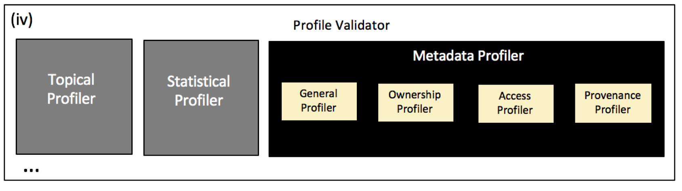
Metadata Validation | step (IV)
The validation process identifies missing or incorrect information and tries to automatically correct them when possible.
The validation is measured against the standard dataset model of the underlying data portal
There exist special validation steps for some fields e.g. emails, urls
We use the HTTP request header information to fix various fields automatically
Enabling Self-service Data Provisioning Through Semantic Enrichment of Data

Slide 32
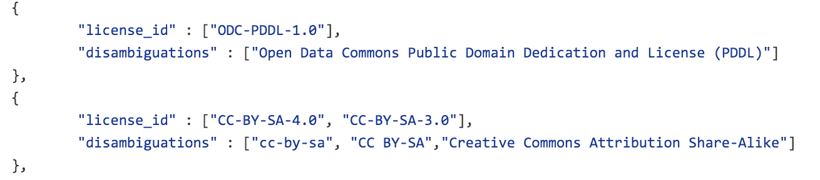
Metadata Validation – License Information | step (IV)
From our experiments, license information were particularly noisy and not standardized e.g. CCZero, CC0
We manually created a license mappings file standardizing the license ID, title and url from the Open Licenses knowledge base
https://github.com/ahmadassaf/opendata-checker/blob/master/util/licenseMappings.json
Enabling Self-service Data Provisioning Through Semantic Enrichment of Data

Slide 33
Manual Reporting
Data portal administrators need an overall knowledge of the datasets and their properties
Roomba allows generation of numerous reports driven by manually entered formatted queries
Meta-field aggregation values e.g. resources>resource_type
Key:object meta-field values: resources>resource_type:resources>name
Empty field values
Enabling Self-service Data Provisioning Through Semantic Enrichment of Data

Slide 34
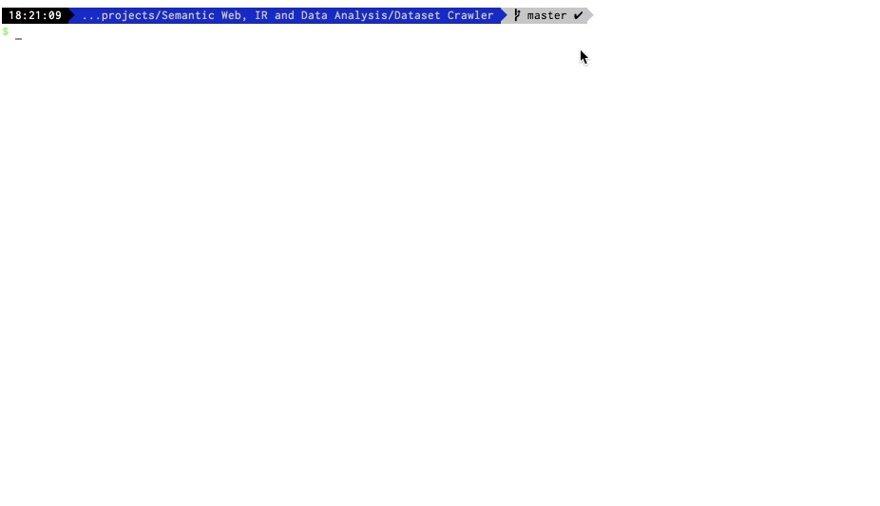

Slide 35
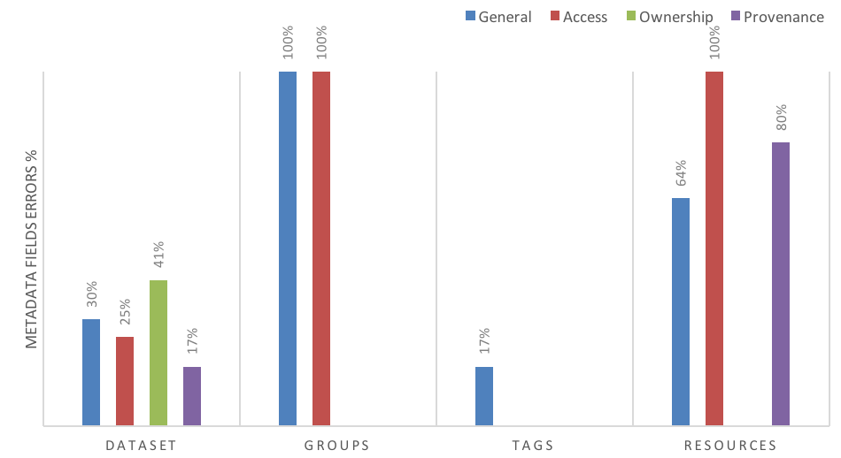
LOD Cloud State | Metadata Errors for Information Groups
41% of ownership information is missing or undefined
Resources have the poorest metadata health across information groups
64% general metadata
100% access metadata
80% provenance metadata
Enabling Self-service Data Provisioning Through Semantic Enrichment of Data

Slide 36
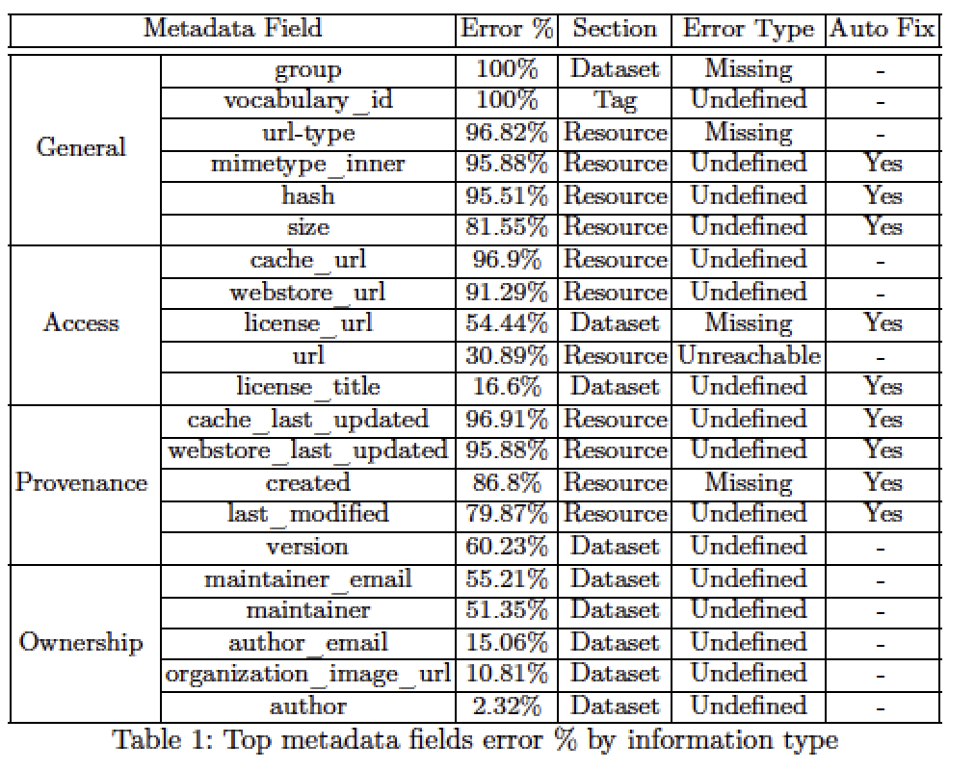
LOD Cloud State | Top Metadata Errors
19% of these errors can be fixed automatically
33.33% can be fixed automatically by tools plugged into the data publishing workflow
Enabling Self-service Data Provisioning Through Semantic Enrichment of Data

Slide 37
LOD Cloud State | Top Metadata Errors
25% of the datasets access information are not clean [unavailability mainly]
68% of the resources access data can be fixed automatically
31.27% of the resources were not reachable
63.17% of the resources don’t have valid resource_type
Creating an aggregate report for resources > format:title
62.16% of the datasets have defined SPARQL endpoints using the api/sparql resource format
92.27% provided RDF example links
56.3% provided direct links to downloadable RDF dumps
Enabling Self-service Data Provisioning Through Semantic Enrichment of Data
Notes:
top errors and top imporvements

Slide 38
LOD Cloud State | Metadata File Types Errors
Enabling Self-service Data Provisioning Through Semantic Enrichment of Data
Notes:
211 (63.17%) resources do not have valid resource_type , 112 (33.53%) are files,
8 (2.39%) a re metadata and one (0.029%) are example and documentation types

Slide 39
LOD Cloud State | Metadata Errors
Noisiest part of the access metadata is license information
16.6% of the datasets don’t have license_title and license_id
54.44% datasets don’t have license_url
51.35% don’t have maintainer
55.21% of the datasets are missing maintainer_email | 15.06% author_email
80% of the provenance information is missing or undefined
The only manual field in provenance information version is missing from 60.23% of the datasets
Enabling Self-service Data Provisioning Through Semantic Enrichment of Data

Slide 40
Flashback | Revisiting Scenario
Paul can use Roomba to automatically fix datasets metadata issues, and notify the datasets owners of the other issues to be manually fixed
Paul will be able now to identify spam datasets. In addition to that, data available in his portal will now have rich semantic information attached to it
Example: temporal and spatial information extracted will be assigned into the corresponding fields in HDL. As an exemplary result, various datasets will be easily identifiable to cover various parts of the UK
Dan will be able to have direct access to rich and high-quality dataset descriptions generated by Roomba
Note: the topical profilers in Roomba will be able to identify occurrences of alcohol related terms like ``wine'' in various datasets. Query expansion methods can be used to relate alcohol to wine allowing him to find the datasets he wants
Enabling Self-service Data Provisioning Through Semantic Enrichment of Data
Notes:
stress on spam

Slide 41
Objective Data Quality Assessment
Data quality assessment is the process of evaluating if a piece of data meets the consumers need in a specific use case
In [Zaveri et.al 2012] lots of the defined quality dimensions are not objective e.g., like low latency, high throughput or scalability.
In addition, there were some missing objective indicators vital to the quality of LOD e.g., indication of the openness of the dataset
ODI does not verify or review submissions but retains the right to revoke the self-certificates at any time
We propose an objective framework to evaluate the quality of Linked Data sources.
Enabling Self-service Data Provisioning Through Semantic Enrichment of Data
Notes:
transition
fix et.al

Slide 42
Objective Data Quality Assessment
Building on the Linked Data principles we group the quality attributes into four main categories:
Quality indicators that focus on the data at the instance level.
Quality indicators at the dataset level.
Quality indicators that focus on the semantic models, vocabularies and ontologies.
Quality indicators that focus on the inbound and outbound links between datasets.
Enabling Self-service Data Provisioning Through Semantic Enrichment of Data
Notes:
★
make your stuff available on the Web (whatever format) under an open license¹
★★
make it available as structured data (e.g., Excel instead of image scan of a table)²
★★★
make it available in a non-proprietary open format (e.g., CSV as well as of Excel)³
★★★★
use URIs to denote things, so that people can point at your stuff⁴
★★★★★
link your data to other data to provide context

Slide 43
Objective Data Quality Assessment
10 Quality Measures
Availability
Licensing
Freshness
64 Quality indicator
Check the resources format field for meta/void value
Check the format and mimetype fields for resources
Check if the content-type extracted from the a valid HTTP request is equal to the corresponding mimetype field
Check if there is at least one resource with a format value corresponding to one of example/rdf+xml, example/turtle, example/ntriples, example/x-quads, example/rdfa, example/x-trig
Enabling Self-service Data Provisioning Through Semantic Enrichment of Data

Slide 44
Objective Data Quality Assessment Tools
Large amount of those indicators can be examined automatically from attached datasets metadata found in data portals
Extensive survey on Linked Data quality tools
Lack in automatic tools to check the dataset quality especially in its completeness, licensing and provenance measures
34 quality indicator are related to the entities and models quality and cannot be checked through the attached metadata
Excluding security related quality indicators the Roomba quality extension is able to assess and score 23 of them (82%)
Enabling Self-service Data Provisioning Through Semantic Enrichment of Data
Notes:
quality indicatros -> add s

Slide 45
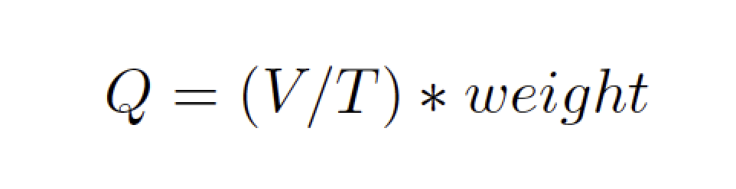
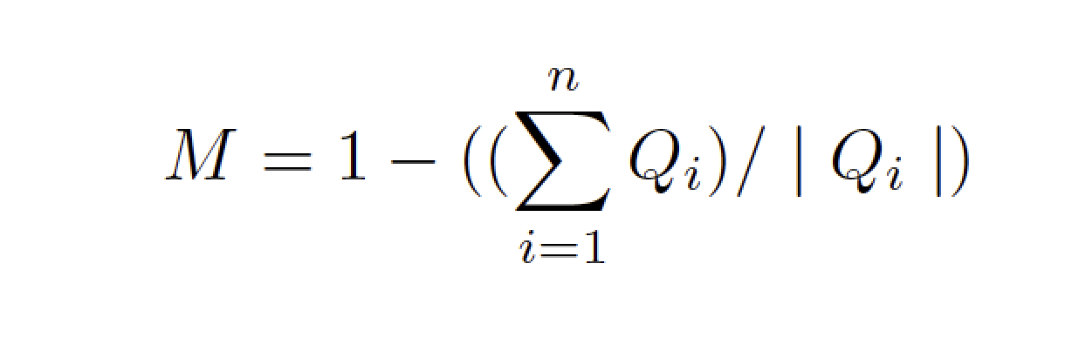
Quality Score Calculation
The quality indicator score is an error ratio based on a ratio between the number of violations V and the total number of instances where the rule applies T multiplied by the specified weight for that indicator
A quality measure score should reflect the alignment of the dataset with respect to the quality indicators
The quality measure score M is calculated by dividing the weighted quality indicator scores sum by the total number of instances in its context
Enabling Self-service Data Provisioning Through Semantic Enrichment of Data
Notes:
put examples

Slide 46
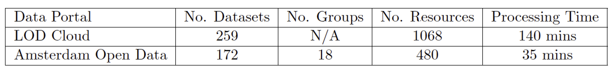
Roomba Experiments & Evaluation
We ran Roomba on two CKAN-based data portals (datahub.io, data.amsterdamopendata.nl)
LOD cloud currently contains 1014 datasets harvested via LDSpider Crawler, however the datahub contains only 259 datasets tagged with “lodcloud” and returned by the CKAN API
We focus on measuring two main aspects: Profiling correctness and completeness
Enabling Self-service Data Provisioning Through Semantic Enrichment of Data

Slide 47
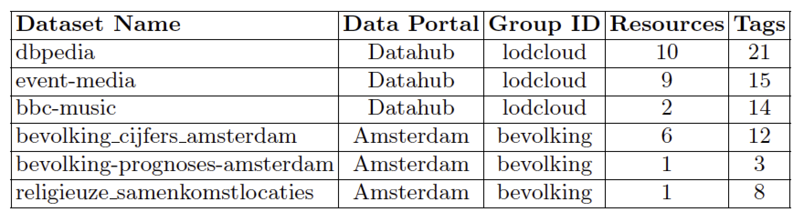
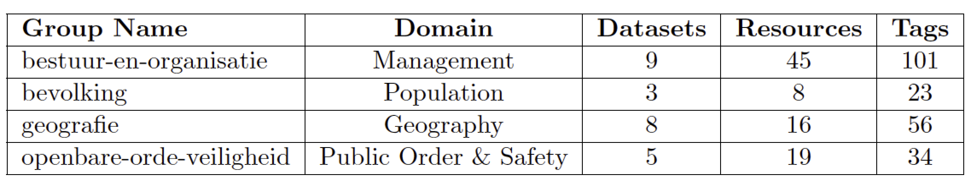
Experiments & Evaluation – Profiling Correctness
Enabling Self-service Data Provisioning Through Semantic Enrichment of Data
Notes:
delete that

Slide 48
Experiments & Evaluation – Profiling Completeness
To analyze the completeness, we manually constructed a synthetic set of profiles
The profiles cover the range of uncommon problems that occur in a certain dataset:
Incorrect resources mimtype or size
Invalid number of tags or resources
Correct normalization of license information: license_id or license_title
Syntactically invalid emails and urls : author_email or maintainer_email
https://github.com/ahmadassaf/opendata-checker/tree/master/test
Enabling Self-service Data Provisioning Through Semantic Enrichment of Data

Slide 49
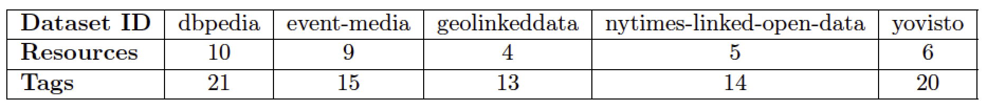
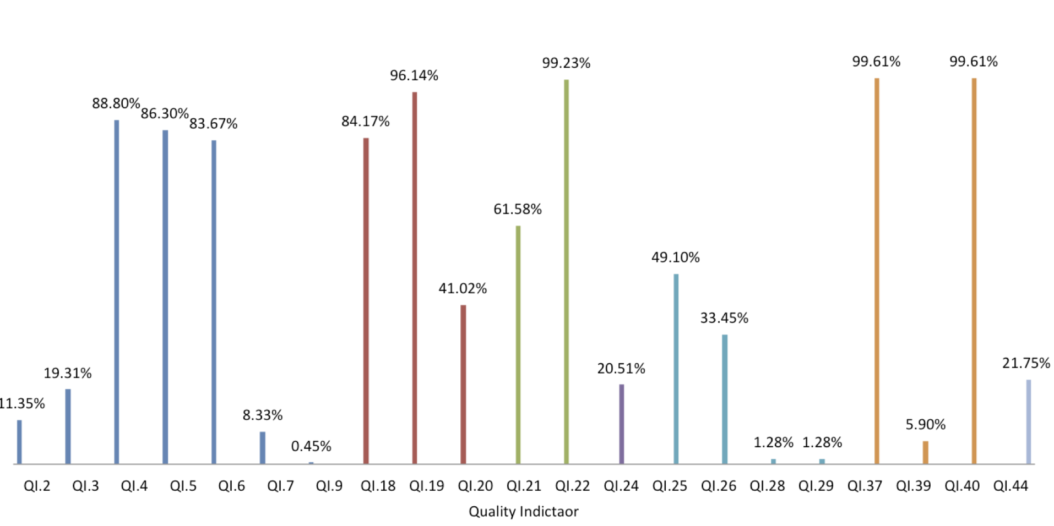
Experiments & Evaluation – Roomba Quality Extension
Profiling Correctness
Profiling Completeness
Enabling Self-service Data Provisioning Through Semantic Enrichment of Data

Slide 50
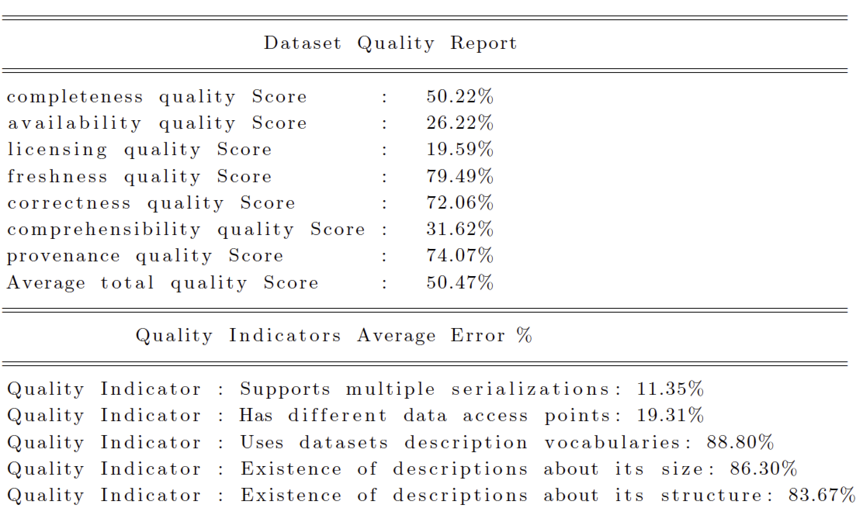
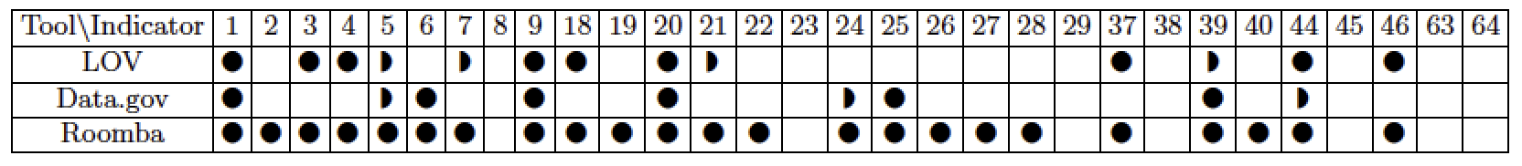
Experiments & Evaluation – Report Sample | LOD Cloud
Enabling Self-service Data Provisioning Through Semantic Enrichment of Data

Slide 51
Proposal
Dataset Maintenance & Discovery
Dataset Quality
Enabling Self-service Data Provisioning Through Semantic Enrichment of Data

Slide 52
Flashback | Revisiting Scenario
Paul will be able now to identify low quality datasets
Dan will be able to have access to cleaner, richer set of datasets
Enabling Self-service Data Provisioning Through Semantic Enrichment of Data

Slide 53
PART II
Towards Enriched Enterprise Data
Research Challenges
Dataset Integration and Enrichment
Enabling Self-service Data Provisioning Through Semantic Enrichment of Data
Notes:
break .. make proper transition
remind the context for the need of data enrichment and integration
explain always why we need this -> justification

Slide 54
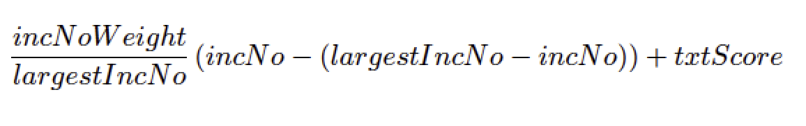
Enterprise Knowledgebase Services
A Knowledge Base (KB) is a large repository of structured and unstructured information representing facts about the general world or specific domains
Dumped DBpedia in SAP HANA and built an contextual entity disambiguation service with leveraging HANA’s built in fuzzy text search combined with a link-based rank approach that takes into account the number of incoming associations
The service is able to identify the most relevant type of an entity taking into account contextual information i.e. When disambiguating entities in tabular data at the cellular level, other cells in the same column represents related context
Enabling Self-service Data Provisioning Through Semantic Enrichment of Data
Notes:
why we need a KB ?
explain what is SAP HANA
explain KB in HANA

Slide 55
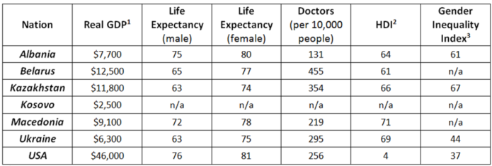
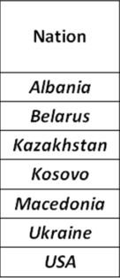
Improving Schema Matching
PL_C
Annotates datasets based on the semantics of the data at the instance level
Instead of looking at the table as a set of records with strings, we represent each instance at the cell level with a set of types retrieved from our service
The column is represented now as a vector of rich types and their corresponding confidence
By normalizing the confidence scores and aggregating the set of types per column, we select the most common type to annotate and label the column
PL_C
PL_C
country:87,3212, music album:12,331,Order of Chivalry:11,2321
……
…….
Enabling Self-service Data Provisioning Through Semantic Enrichment of Data
Notes:
introduce schema matching
and how i have applied my work in it
put back scneario .. why i need schema matching
take Dan back here
introduce relevant datasets

Slide 56
Improving Schema Matching
Added the semantic matching to the Auto Mapping Core (AMC)
Evaluated against data coming from two SAP systems: The Event Tracker and Travel Expense Manager
Increased the overall confidence score with an average of 11% and the number of valid matches found with an average of 10%
Enabling Self-service Data Provisioning Through Semantic Enrichment of Data

Slide 57
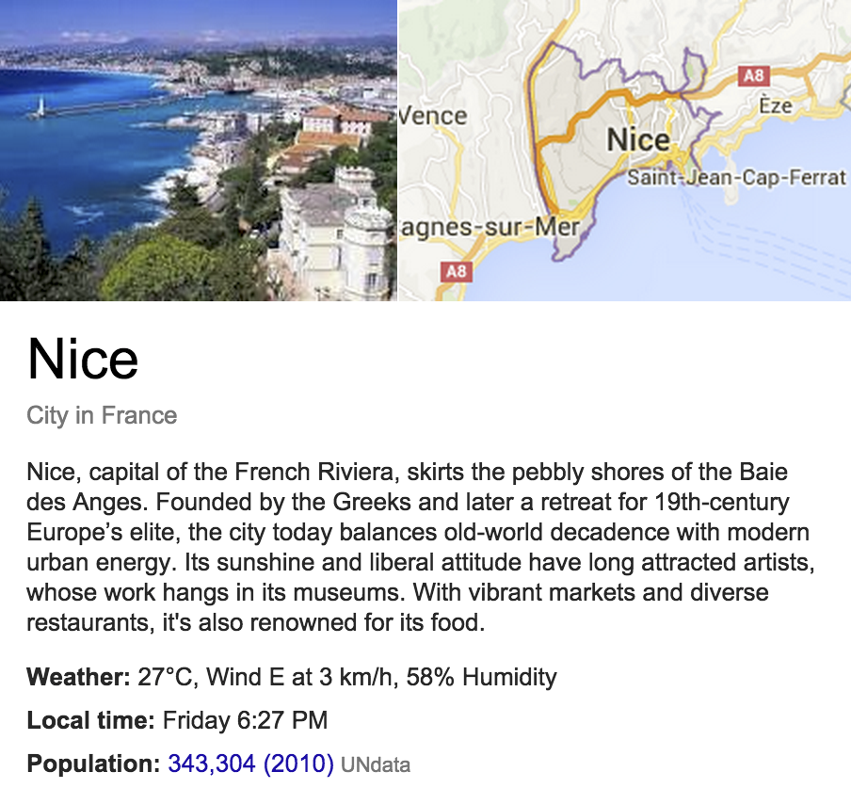
Data Enrichment | Properties Ranking
Entities are generally described with a lot of properties. However, not all properties have the same importance
Some entities properties are considered as keys for performing instance matching tasks while other properties are generally chosen for quickly providing a summary of the key facts attached to an entity
We performed a reverse engineering of the Google Knowledge Graph Panel to find out what are the most “important" properties for an entity according to Google and measured that against a survey conducted on 152 users
Enabling Self-service Data Provisioning Through Semantic Enrichment of Data
Notes:
put relevant example
show propertis in dbepdia and same in google

Slide 58
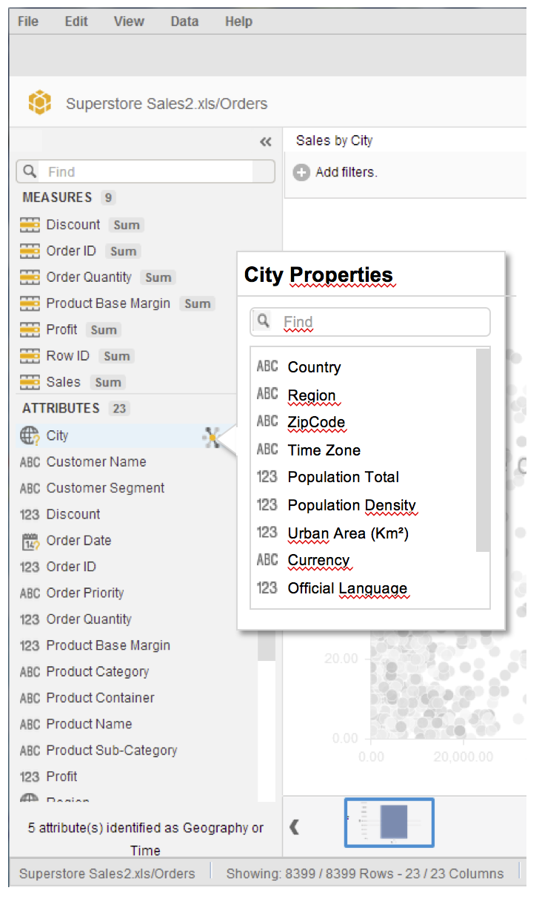
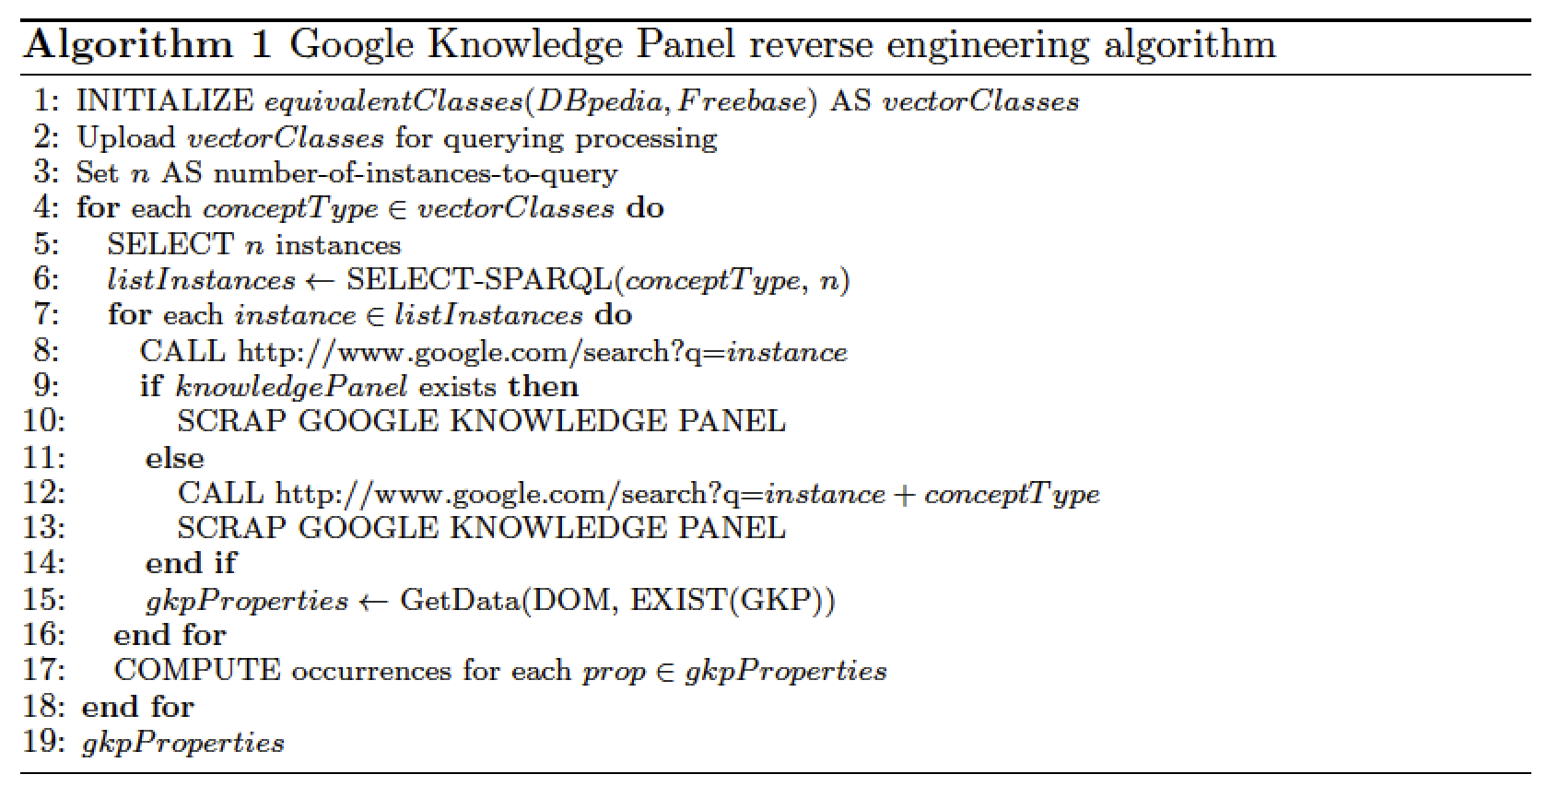
Data Enrichment | Properties Ranking
Enabling Self-service Data Provisioning Through Semantic Enrichment of Data

Slide 59
Flashback | Revisiting Scenario
Dan now has access to various datasets that he found matching his query to the portal administered by Paul
Having imported those dataset into Lumira, Dan will be also able to use the internal knowledge base to apply various semantic enrichments on this data
Dan will be also able to use the schema matching services to find and merge those datasets in his reports
Dan will be able to annotate and enrich his reports with external data
Example: Dan will be able to name and reconcile noisy cell values and column labels
Enabling Self-service Data Provisioning Through Semantic Enrichment of Data

Slide 60
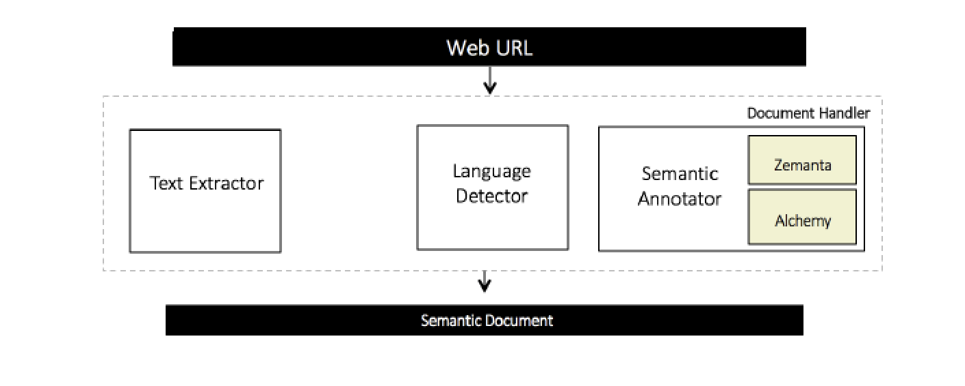
Semantic Social News Aggregation | SNARC
SNARC is a service that extracts the semantic context of documents in order to recommend related content from the web and social media
SNARC consists of three major components:
Document handler that creates a ``Semantic Model'' representing any web resource
Query layer that is responsible for disseminating queries to the supported social services
Data parser which processes the search results, wraps them in a common social model and generates the desired output.
SNARC provides a uniform semantic document model for web entities, whether they are blog entries, multimedia objects or micro-posts
Enabling Self-service Data Provisioning Through Semantic Enrichment of Data

Slide 61
Semantic Social News Aggregation | SNARC
Example of a semantic document for “Turkey protests: Erdogan in `final' warning”
Categories: Culture_Politics, Regional and Society
Keywords: Taksim Square, Protesters, Gezi Park, Mr Erdogan, Istanbul
Entities : Gezi Park, Recep Tayyip Erdogan, Taksim Square, Justice and Development Party (Turkey), Police of Turkey
Enabling Self-service Data Provisioning Through Semantic Enrichment of Data

Slide 62
Semantic Social News Aggregation | SNARC
SNARC is a service that generates a JSON file containing the results wrapped in our universal social model
As a possible front-end implementation, we have implemented a chrome extension that loads SNARC on any web page or application
This implementation offers more flexibility to users by loading related social news anytime on any webpage or application. The results are visualized using as a sliding panel on one of the screen edges, extracted entities are highlighted in the page itself and a short excerpt is displayed when hovering over them.
Enabling Self-service Data Provisioning Through Semantic Enrichment of Data

Slide 63
Proposal
Dataset Integration & Enrichment
Enabling Self-service Data Provisioning Through Semantic Enrichment of Data

Slide 64
Revisit: Use-case Scenario
Dan receives a memo from his management to create a report comparing the number of car accidents that occurred in France for this year, to its counterpart in the United Kingdom (UK).
Dan asked to highlight accidents related to illegal consumption of alcohol in both countries.
Enabling Self-service Data Provisioning Through Semantic Enrichment of Data
Notes:
After examining the ministry's records, Dan is able to collect the data needed to create his report for the French side. Dan also issues an official request to the Department of Transport in UK to collect the data needed. However, Dan knows that the process takes a long time and his management needs the report within days. Dan is familiar with the Open Data movement and starts his journey searching through different data portals in the UK.

Slide 65
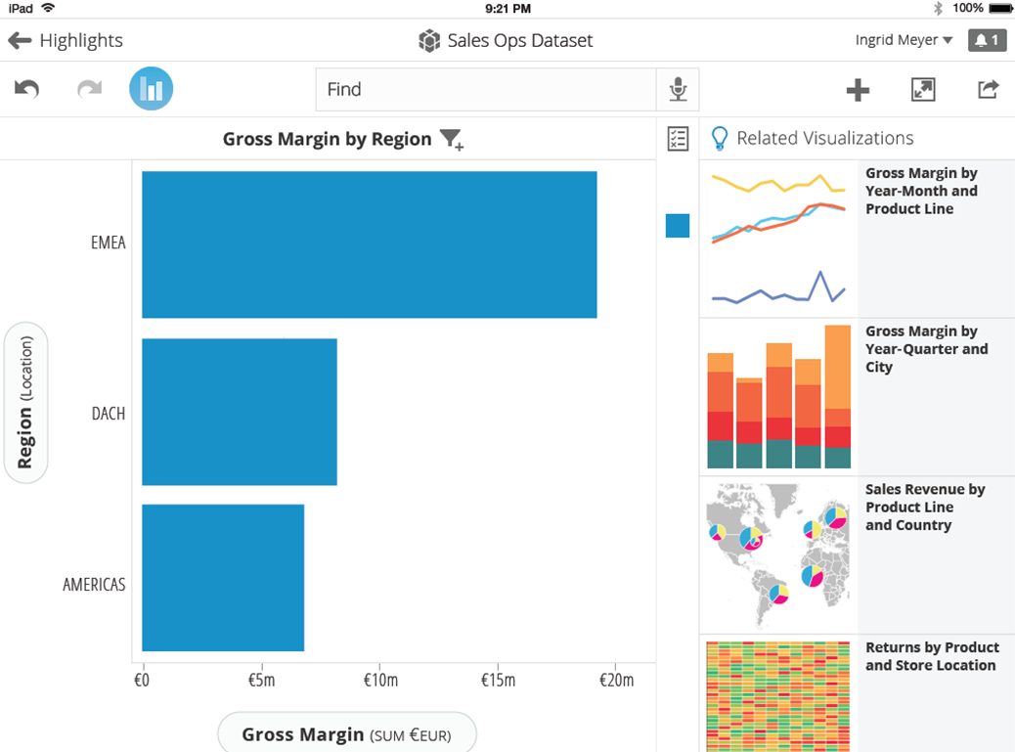
Dan Ferry
Chemicals driving accidents
Accidents Cost by Region
Related Datasets
Road traffic accidents involving alcohol (% of all traffic crashes)
World Health Organization
Alcohol – Drink – Car – Transportation Method , Accident
Drunk driving in the United States
Wikipedia
Alcohol – United States – Drunk - Driving
Transportation Accidents by Mode
Bureau of Transportation Statistics
Transportation – Accident – Car – Bus - Motorcycle
Alcohol Beverage Sampling Program
Department of the Treasury
Alcohol – Beverage – Wine - Spirits
@datagovuk | new data published, road accidents in middlands http://bit.ly/qwe1k
Source: Twitter
12

Slide 66
Perspectives
Data Profile Representation
HDL as an ontology
Extend HDL with a set of enumerations as values to ensure a unified fine-grained representation of a dataset
Present mappings in a machine readable format will allow various tools to use it
Automatic Dataset Profiling
Integrating statistical and topical profilers to allow generation of full comprehensive profiles
Extend Roomba to be able to run over other data portal types like DKAN or Socrata
Add the ability to correct the rest of the metadata either automatically or through intuitive manually-driven interfaces
Enabling Self-service Data Provisioning Through Semantic Enrichment of Data

Slide 67
Perspectives
Objective Linked Data Quality
Integrate tools assessing models quality in addition to syntactic checkers
Suggest weights to those indicators which will result in a more objective quality calculation process
Enterprise Data Integration
Integrating additional linked open data sources of semantic types such as YAGO
Better evaluation of the Knowledge Graph scraper with an enhanced survey
Evaluate our matching results against instance-based ontology alignment benchmarks
Enabling Self-service Data Provisioning Through Semantic Enrichment of Data

Slide 68
Publications
Journals
Ahmad Assaf, Raphaël Troncy and Aline Senart: Towards An Objective Assessment Framework for Linked Data Quality. International Journal On Semantic Web and Information Systems, Minor revision, 2015
Conferences
Ahmad Assaf, Raphaël Troncy and Aline Senart: Automatic Validation, Correction and Generation of Dataset Metadata - Enhancing Dataset Search and Spam Detection. In 24th International World Wide Web Conference (WWW 2015), Demo Track, May 2015, Florence, Italy
Ahmad Assaf, Ghislain Atemezing, Raphaël Troncy and Elena Cabrio: What are the important properties of an entity? Comparing users and knowledge graph point of view. In 11th Extended Semantic Web Conference (ESWC 2014), Demo Track, May 2014, Heraklion, Crete
Ahmad Assaf, Aline Senart and Raphaël Troncy: SNARC - An Approach for Aggregating and Recommending Contextualized Social Content. In 10th Extended Semantic Web Conference (ESWC 2013), Sattelite Events, May 2013, Montpellier, France.
1st Prize Winner of the AI Mashup Challenge
Enabling Self-service Data Provisioning Through Semantic Enrichment of Data

Slide 69
Publications
Workshops
Ahmad Assaf, Raphaël Troncy and Aline Senart: What's up LOD Cloud - Observing The State of Linked Open Data Cloud Metadata. In 2nd Workshop on Linked Data Quality (LDQ), May 2015, Portoroz, Slovenia
Best paper award
Ahmad Assaf, Raphaël Troncy and Aline Senart: HDL - Towards A Harmonized Dataset Model for Open Data Portals. In 2nd International Workshop on Dataset PROFIling & fEderated Search for Linked Data (PROFILES), May 2015, Portoroz, Slovenia
Ahmad Assaf, Raphaël Troncy and Aline Senart: An Extensible Framework to Validate and Build Dataset Profiles. In 2nd International Workshop on Dataset PROFIling & fEderated Search for Linked Data (PROFILES), May 2015, Portoroz, Slovenia.
Best paper award
Ahmad Assaf, Aline Senart and Raphaël Troncy: Data Quality Principles in the Semantic Web. In International Workshop on Data Quality Management and Semantic Technologies (DQMST), July 2012, Palermo, Italy
Ahmad Assaf, Eldad Louw, Aline Senart, Corentin Follenfant Raphaël Troncy and David Trastour: RUBIX: a Framework for Improving Data Integration with Linked Data. In 1st International Workshop on Open Data (WOD), June 2012, Nantes, France.
Enabling Self-service Data Provisioning Through Semantic Enrichment of Data

Slide 70
THANK YOU
Questions?
Ahmad Assaf
http://ahmadassaf.com/
@ahmadaassaf
http://github.com/ahmadassaf
Enabling Self-service Data Provisioning Through Semantic Enrichment of Data
Enabling Self-service Data Provisioning Through Semantic Enrichment of Data

